Slide 1
IMAGE PROCESSING
By
Viral 3

Slide 2
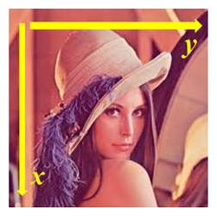
Basic image manipulations
Different Python libraries can be used for basic image manipulation. Almost all of the libraries store an image in numpy ndarray (a 2-D array for grayscale and a 3-D array for an RGB image, for example). The following figure shows the positive x and y directions (the origin being the top-left corner of the image 2-D array) for the colored lena image:

Slide 3
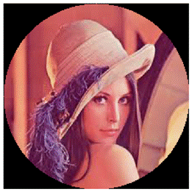
8-Image manipulations with numpy array slicing
how slicing and masking with numpy arrays can be used to create a circular mask on the lena image:
Output:
***Providing the correct path to the images on the disk***

